Slide 1
TRAINING ON TAMIL NADU NEW TEXT BOOK
+2 BOTANY
Unit X: Economic Botany
Economically Useful Plants
and
Entrepreneurial botany
.

Slide 2
Learning objective
The learner will be able to Acquire knowledge about origin, area of cultivation and uses of various food yielding plants.
Describe the different spices and condiments and their uses.
Elicit the uses of fibre, timbers, paper and dye yielding plants.

Slide 3
… Learning objective
Acquires knowledge about the active principles, chemical composition and medicinal uses of plants.
Develops skill of mushroom cultivation, knowledge of SCP production and sea weed liquid fertilizers.
Gains knowledge of organic farming- bio fertilisers and bio pest repellants. Learn to make terrarium and bonsai.
Acquires knowledge of cultivation of medicinal plants.

Slide 4
Chapter outline
10.1 Food Plants
10.2 Spices and Condiments
10.3 Fibre
10.4 Timber
10.5 Latex
10.6 Pulp wood
10.7 Dye
10.8 Cosmetics
10.9 Traditional system of medicines
10.10 Medicinal plants
10.11 Entrepreneurial Botany

Slide 5
Food plants
Currently about 10,000 food plants are being used of which only around 1,500 species were brought under cultivation.
Cereals .
Greater adaptability and successful colonisation on every type of habitat.
The relative ease of cultivation.
Tillering property that produce more branches which results in higher yield per unit area.
Compact and dry grains that they can be easily handled, transported and stored without undergoing spoilage.
High caloric value that provides energy.

Slide 7
Oryza sativa
Triticum aestivum
Zea mays
Pennisetum americanum
Eleusine coracana
Sorghum vulgare

Slide 9
Panicum sumatrense
Setaria italica
Paspalum scrobiculatum
Vigna mungo
Vigna radiata
Cajanus cajan
Cicer arietinum

Slide 10
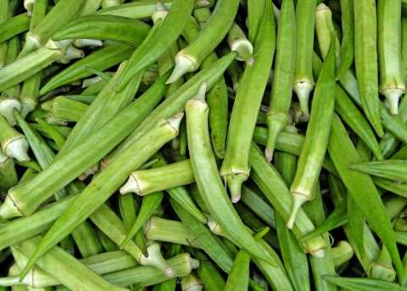
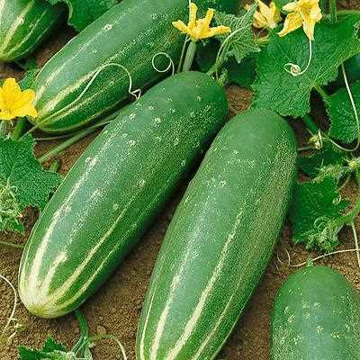
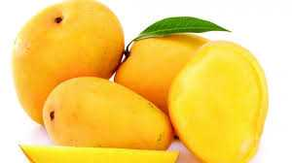
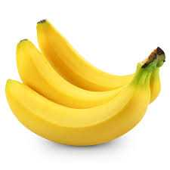
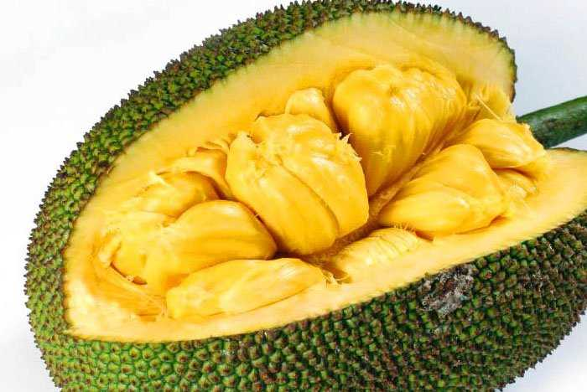
Solanum tuberosum Abelmoschus esculentus Cucumis sativus
Mangifera indica Musa x paradisiaca Artocarpus heterophyllus

Slide 12
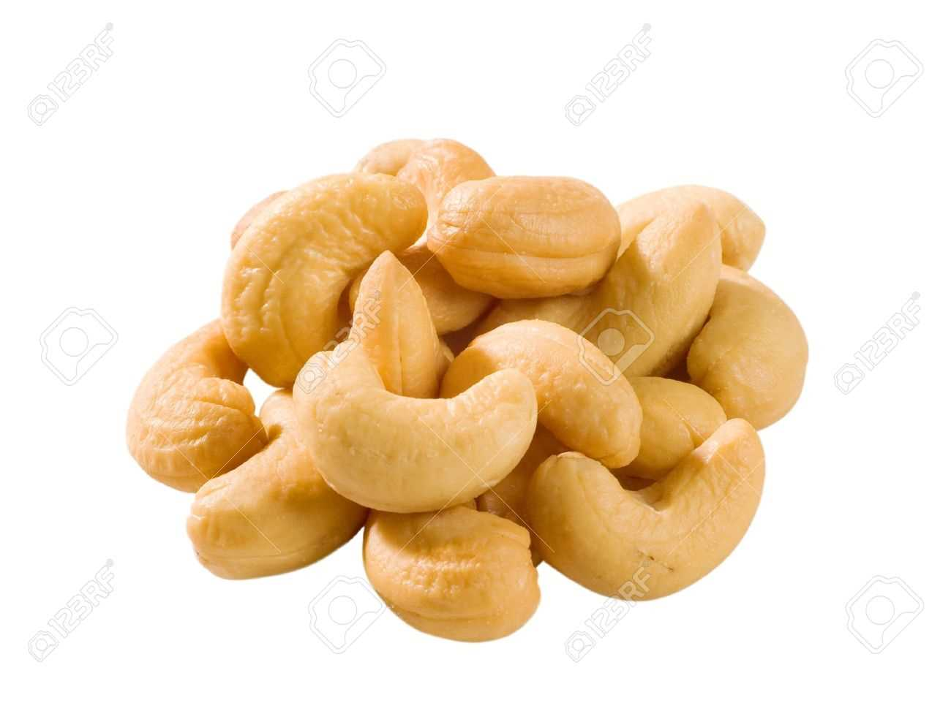
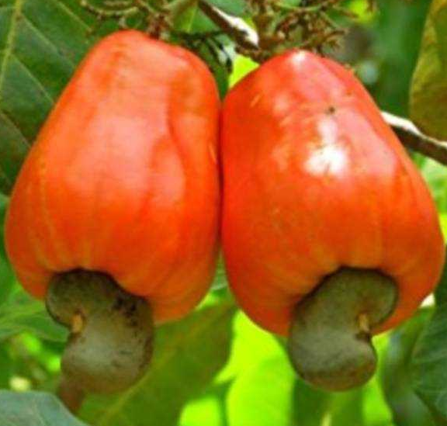
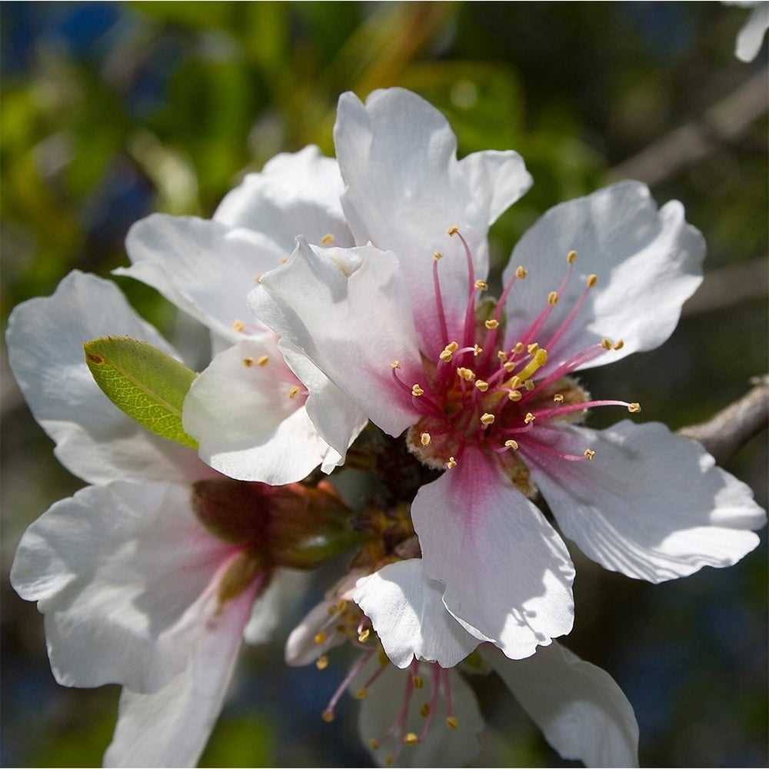
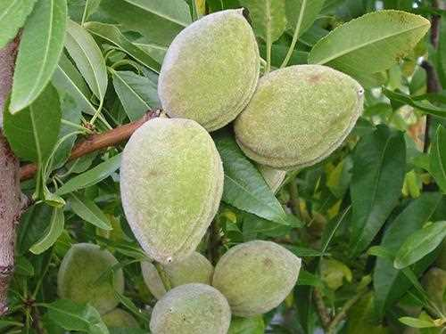
Anacardium occidentale
Prunus dulcis
Saccharum officinarum
Stevia rebaudiana
Borassus flabellifer

Slide 13
Oil Seeds

Slide 14
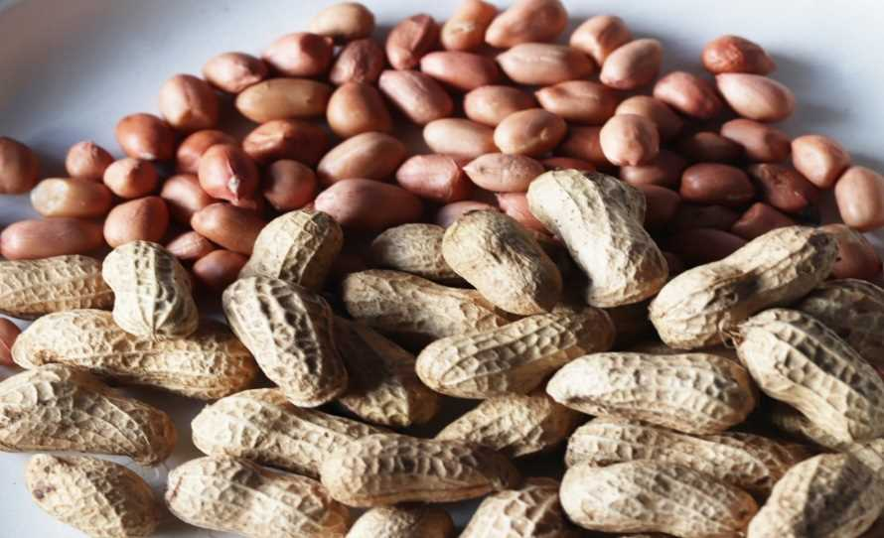
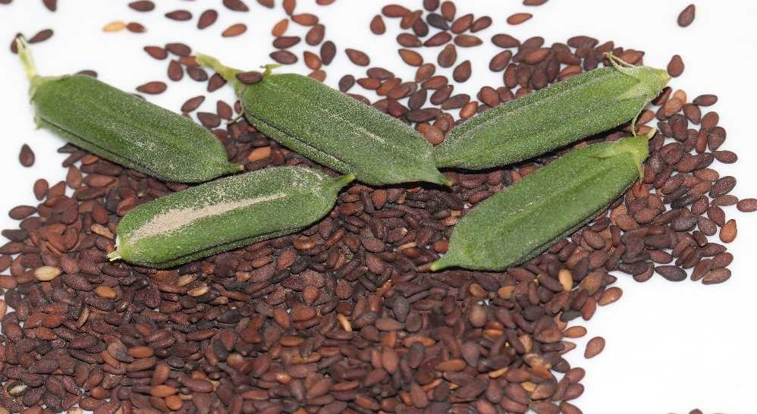
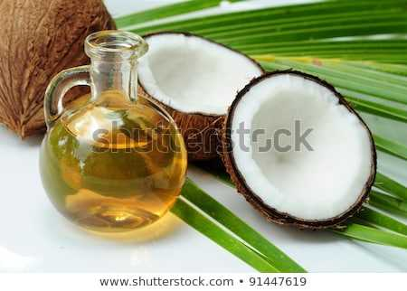
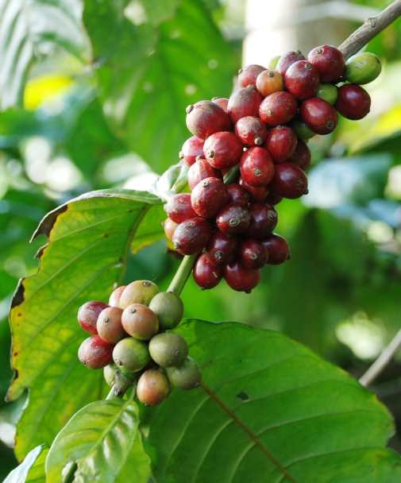
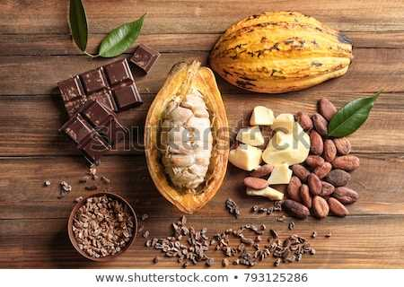
Fatty acids in Oils
Arachis hypogaea
Sesamum indicum
Cocos nucifera
Premium cooking oil
This oil is the basis of most of the scented oils used in perfumes.
This is an edible-industrial oil.
Camellia sinensis
Coffea arabica
Theobroma cacao
Beverages
‘food of the Gods’.
Rich in fibres, minerals and antioxidants, thus preventing cancer,cardiovascular diseases, premature ageing.
green tea lowers the bad cholesterol and increases the good cholesterol.
Caffeine enhances release of acetylcholine in brain, which in turn enhances efficiency.

Slide 15
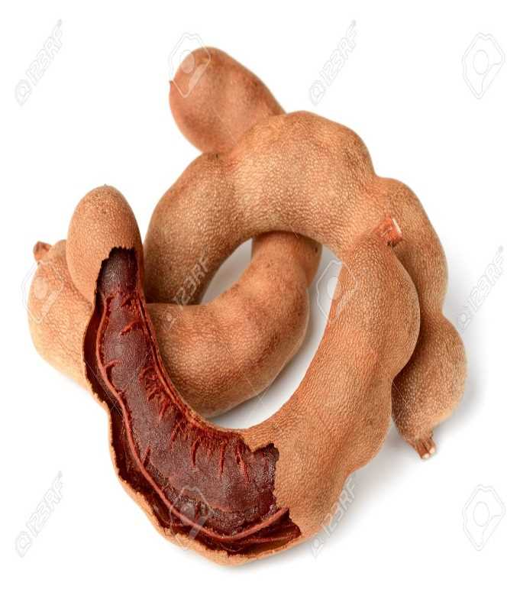
Spices and Condiments
Elettaria cardamomum
Piper nigrum
Curcuma longa
Capsicum annuum
Tamarindus indica

Slide 17
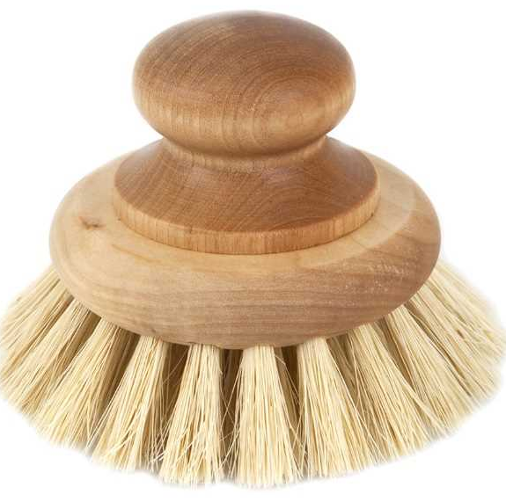
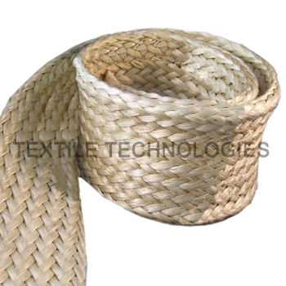
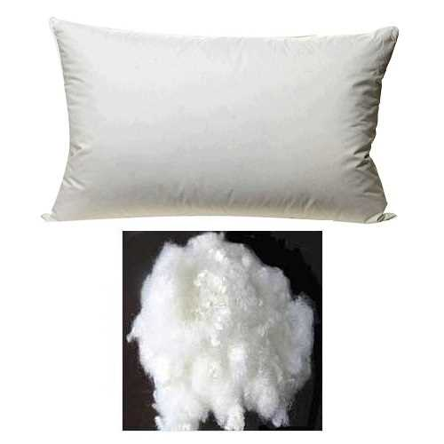
Fibres

Slide 18
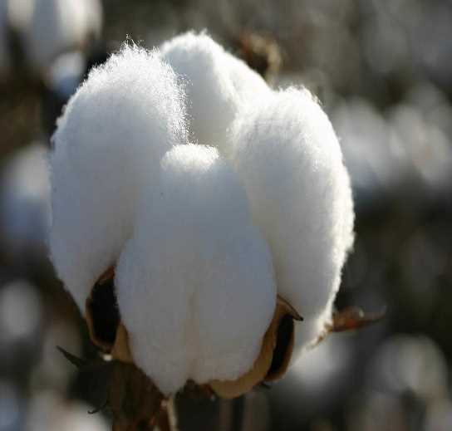
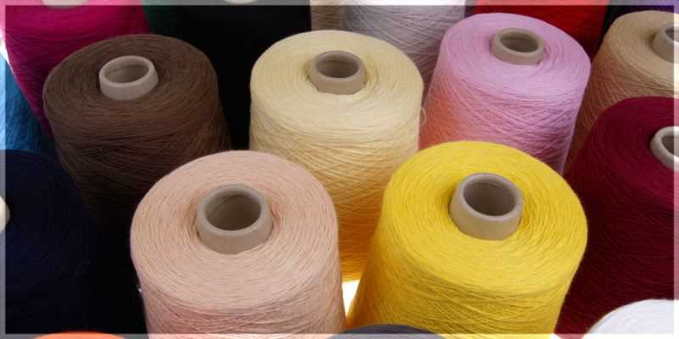
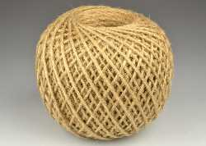
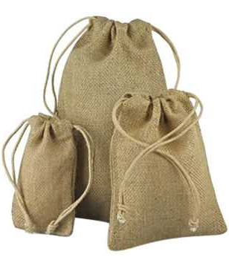
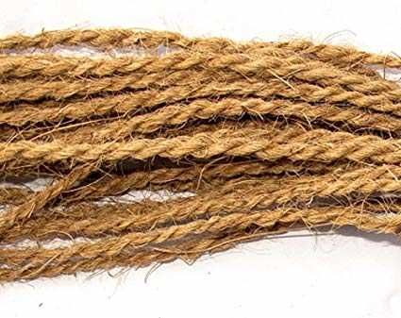
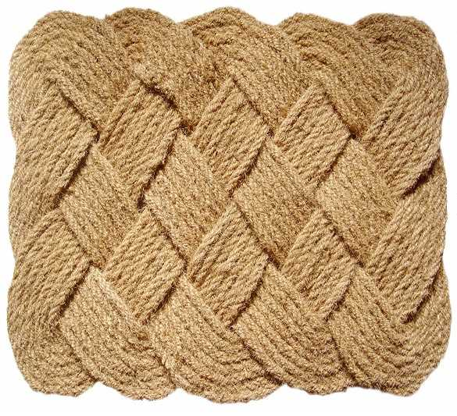
Fibres
Cotton
Gossypium spp.
(1) G. hirsutum
(2)G.barbadense
are the New world species
(3) G. arboretum
(4) G. herbaceum
Jute
Corchorus spp.
From the two cultivated species (1) Corchorus capsularis - Indo-Burmese origin.
(2) C.olitorius -African origin
Coconut / Coir
Cocos nucifera
It is used in manufacture of mats, cushion seats, bags, packaging material, water-proof and sound
proof boards and thermal insulation.

Slide 19
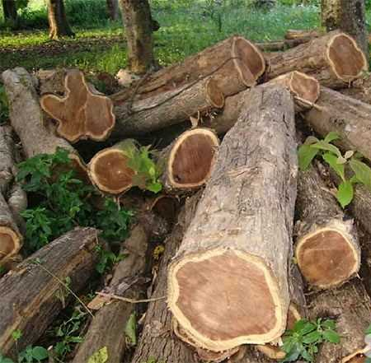
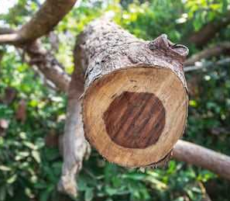
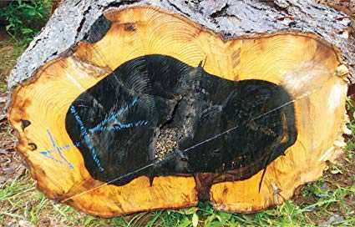
Timber
Tectona grandis
Dalbergia latifolia
Diospyros ebenum
Native to South east Asia.
The heartwood is golden yellow to golden brown when freshly sawn, turning darker when exposed to light. Known for its durability as it is immune to the attack of
termites and fungi.
Native to India.
Indian rosewood has yellowish sapwood and dull brown to almost purple coloured heartwood.
The heartwood is jet black with a metallic lustre when smoothened and is resistant to attack by
insects and fungi.

Slide 20
Latex - Rubber
Hevea brasiliensis

Slide 21
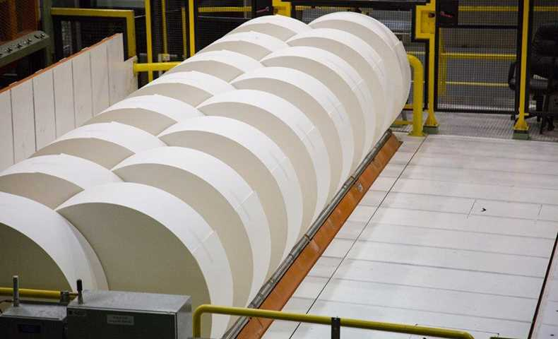
Pulp Wood
The term paper is derived from the word ‘papyrus’ a plant (Cyperus papyrus) that was used by Egyptians to make paper-like materials.
The Chinese discovered the paper that was prepared from the inner bark of paper mulberry in 105 A.D.

Slide 22
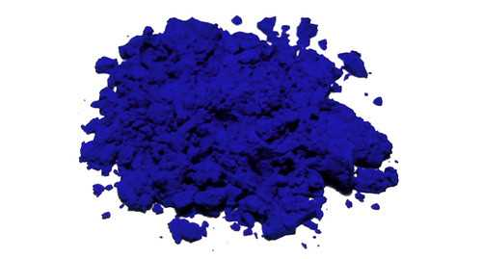
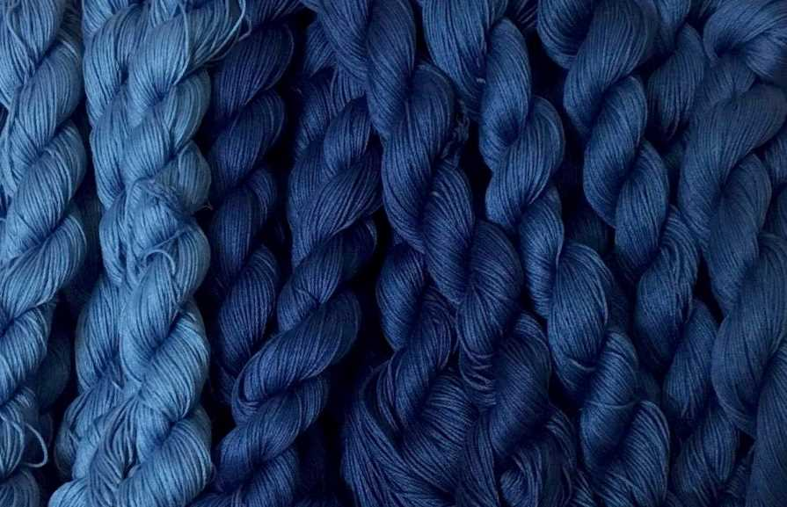
Indigo
Indigofera tinctoria is native to India.
A brilliant dark blue dye ‘indigo’ was extracted from the leaves of several species of Indigofera.

Slide 23
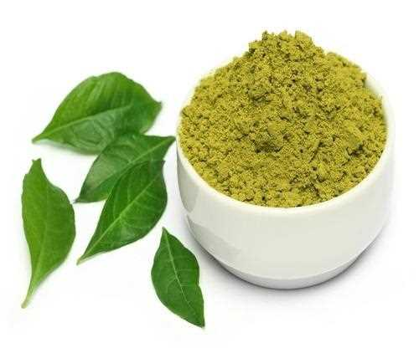
Indigenous to North Africa and South-west Asia. Principal colouring matter of leaves ‘lacosone” is harmless .
Henna
Lawsonia inermis

Slide 24
Spices and Condiments
Provide personal care services .
‘Aloin’ (a mixture of glucosides)
Premium cooking oil
the oil is the basis of most of the scented oils used in perfumes.
Arachis hypogaea
Sesamum indicum
Cocos nucifera

Slide 25
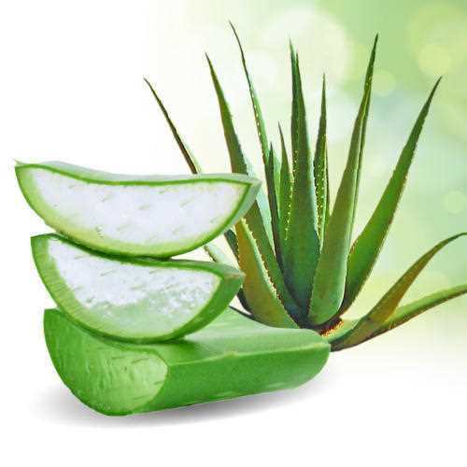
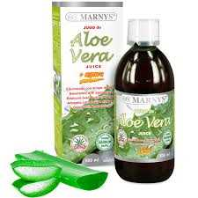
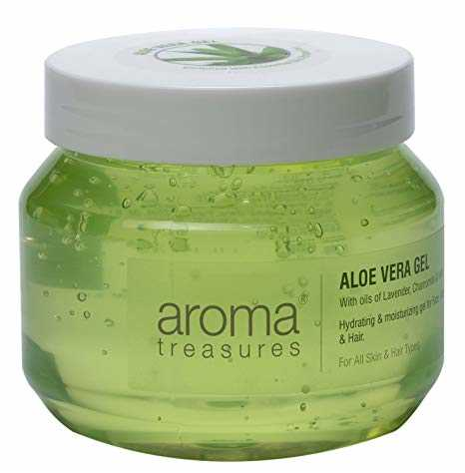
Cosmetics Aloe vera
Provide personal care services .
‘Aloin’ (a mixture of glucosides)

Slide 26
Perfumes
Perfumes are manufactured from essential oil which are volatile and aromatic.
Essential oils are found at different parts of the plant.
Santalum album Santalum album Santalum album Santalum album
Jasminum grandiflorum
Rosa X damascena
Santalum album

Slide 27
Traditional Systems of Medicines
TSM in India can be broadly classified into institutionalized or documented and
non-institutionalized or oral traditions.
Institutionalized Indian systems include Siddha and Ayurveda.
Non- institutional systems are practiced by rural and tribal peoples across India. The knowledge is mostly held in oral form.
TSM focus on healthy lifestyle and healthy diet for maintaining good health and disease reversal.

Slide 28
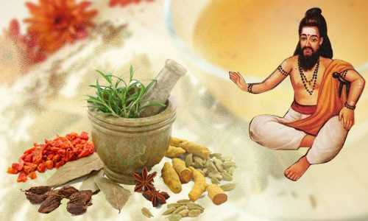
Siddha system of medicine
It is based on the texts written by 18Siddhars.
Siddha is principally based on the Pancabuta philosophy. According to this system three humors namely Vatam, Pittam and Kapam that are responsible for the health of human.
The drug sources of Siddha
include plants, animal parts,
marine products and minerals.
This system uses about 800
herbs as source of drugs.

Slide 29
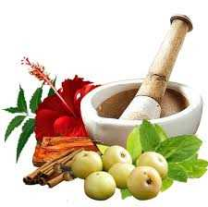
Ayurveda system of medicine
The core knowledge is documented by Charaka, Sushruta and Vagbhata in compendiums written by them.
This system Uses more of herbs
and few animal parts as drug
sources.
The Ayurvedic Pharmacopoeia of
India lists about 500 plants used
as source of drugs.

Slide 30
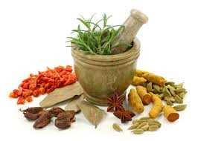
Folk system of medicine
Folk systems survive as an oral
tradition among innumerable
rural and tribal communities
of India.
Major tribal communities in
Tamil Nadu who are known for
their medicinal knowledge include Irulas,
Malayalis, Kurumbas, Paliyans and Kaanis.

Slide 32
Medicinal Plants
India is a treasure house of medicinal plants.
They are linked to local heritage as well as to global-trade.
90% collection of medicinal plants is from the non-cultivated sources.
Medicinally useful molecules obtained from plants that are marketed as drugs are called Biomedicines.
Phyllanthin
Vascin
Andrographolides
Curcumin

Slide 33
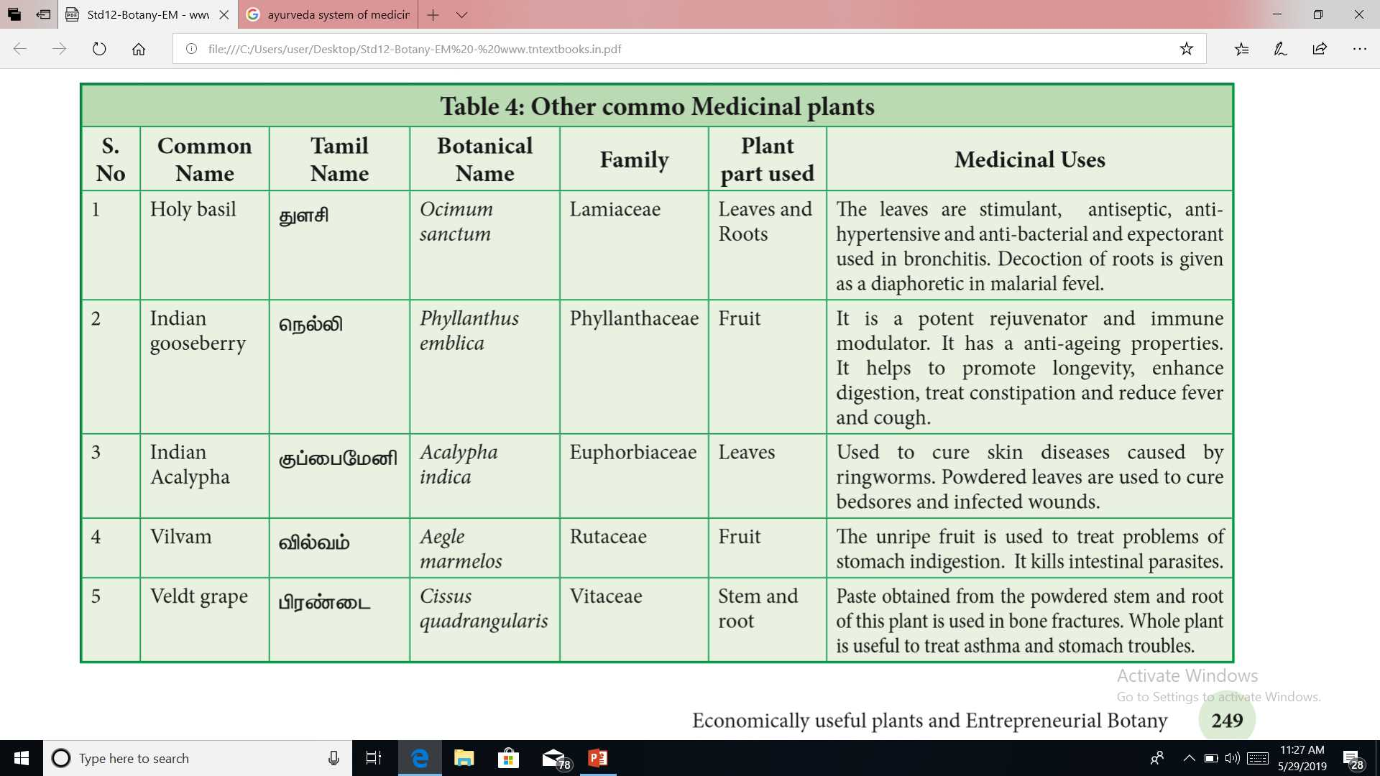
n

Slide 36
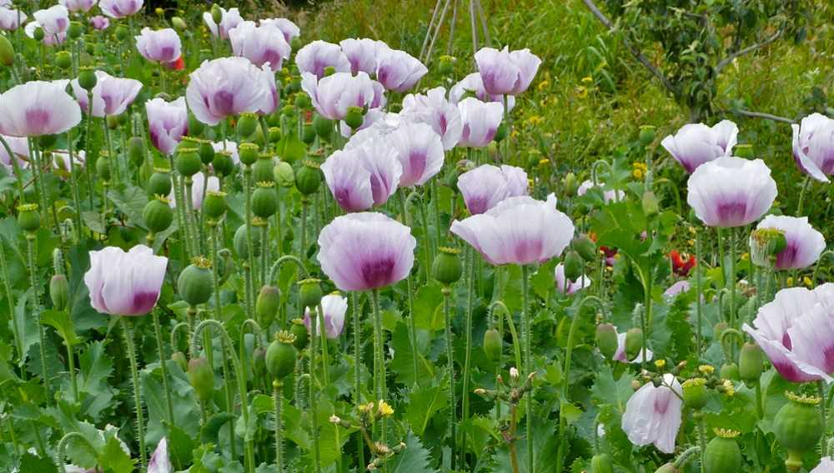
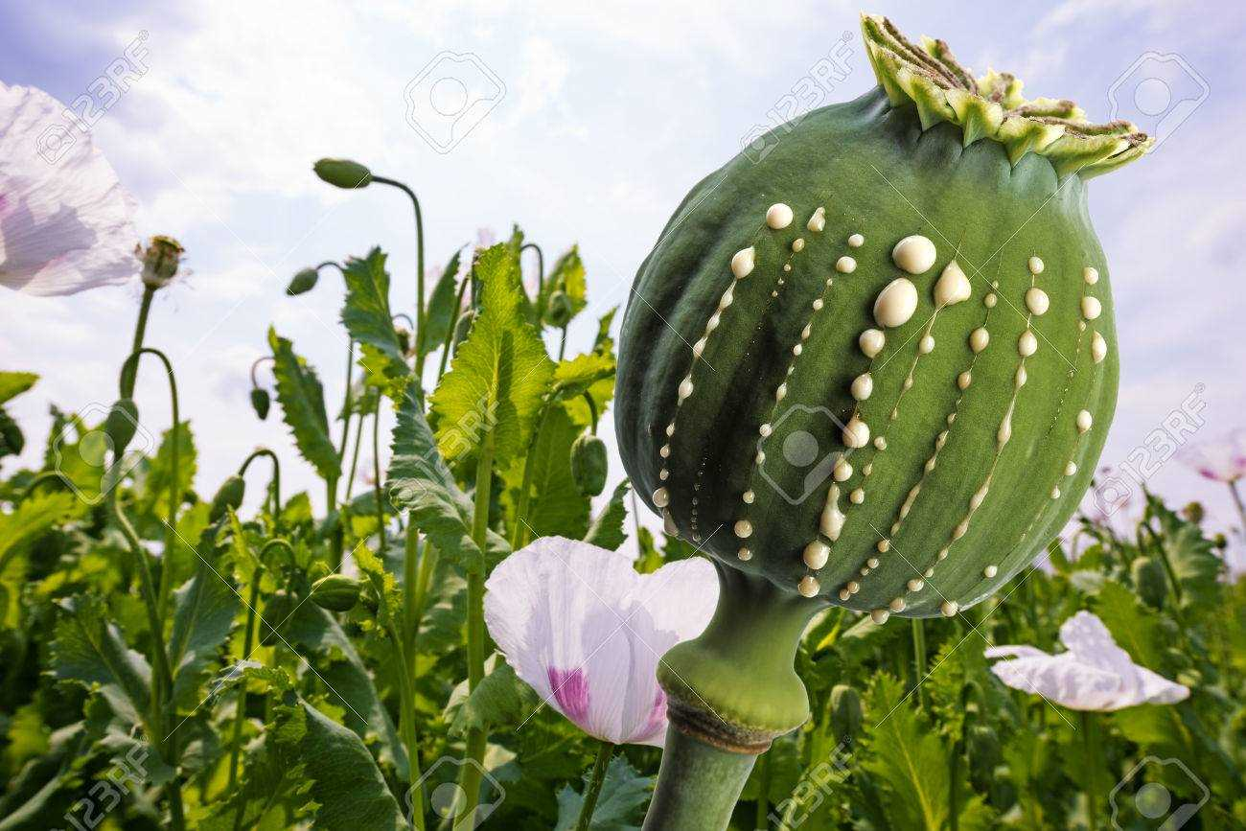
Psychoactive Drugs
Phytochemicals which alter an individual’s perceptions of mind by producing hallucination are known as psychoactive drugs.
Papaver somniferum
Used to induce sleep and for relieving pain. Opium yields Morphine, a strong analgesic which is used in surgery.

Slide 37
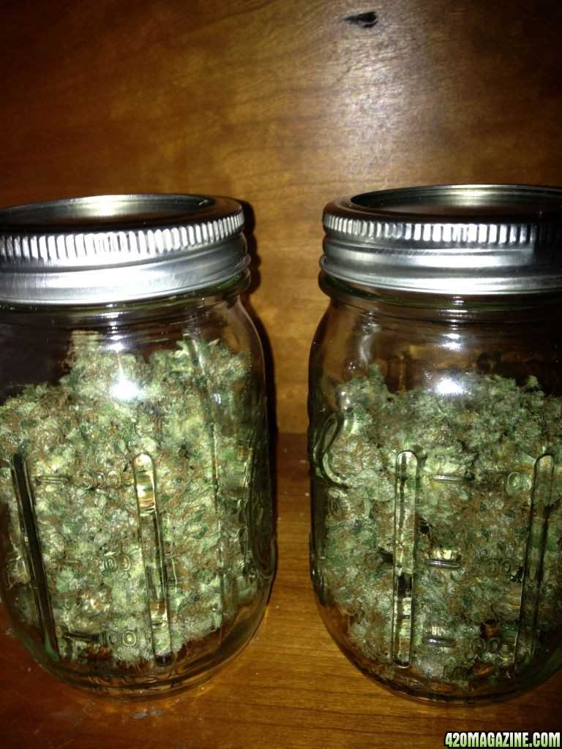
Cannabis sativa – specimen
trans-tetrahydrocanabinal
It is an effective pain reliever and reduces hypertension. THC is used in treating Glaucoma, reducing nausea of cancer patients undergoing radiation and chemotherapy, provides relief to bronchial disorders, especially asthma as it dilates bronchial vessels.

Slide 38
Entrepreneurial Botany
Study of how new businesses are created using plant resources as well as the actual process of starting a new business.
An entrepreneur is someone who has an idea and who works to create a product or service that people will buy, by building an organization to support the sales.
To create new ventures among the young people.
In the present scenario students should acquire ability to merge skills and knowledge in a meaningful way.

Slide 39
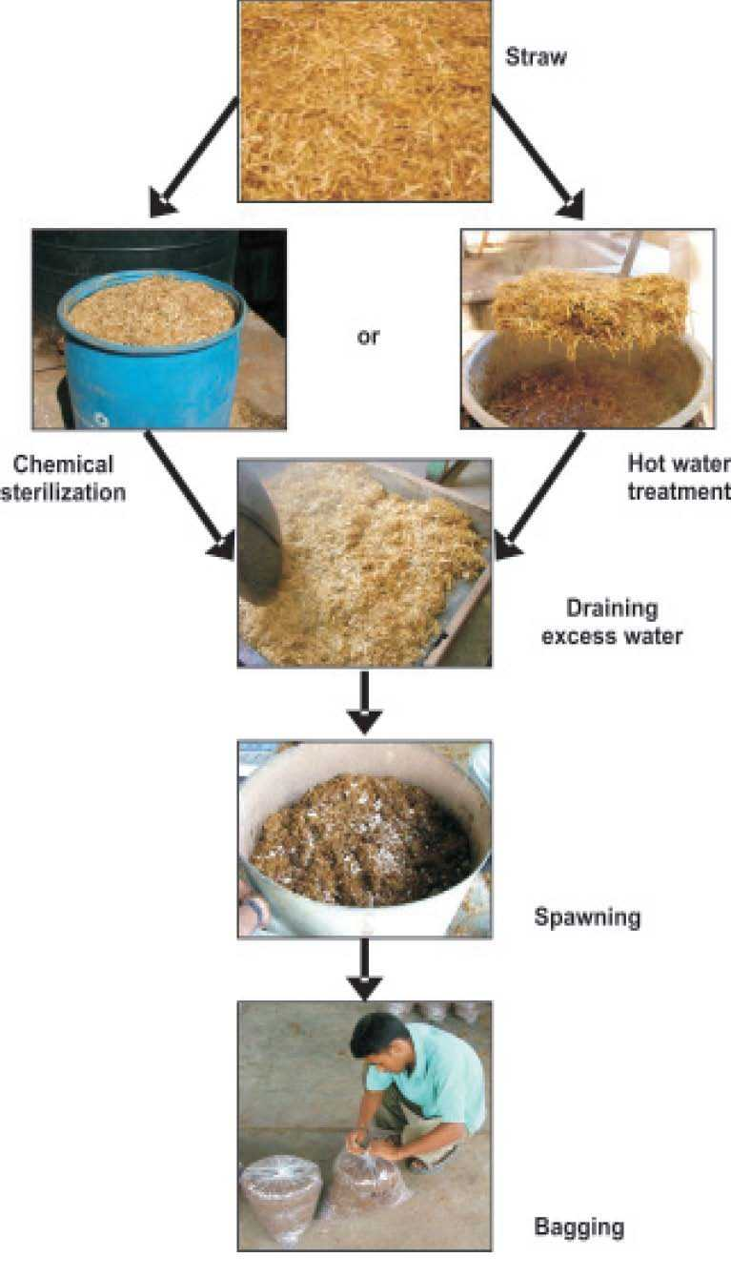
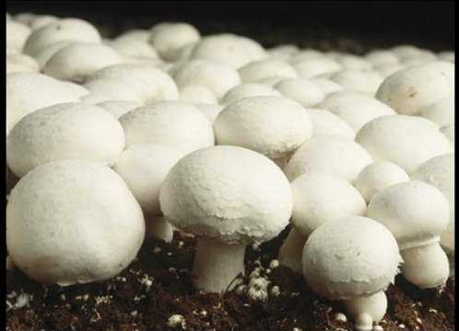
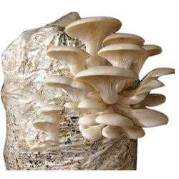
Mushroom cultivation
Two kinds of mushrooms are cultivated
namely button and oyster.

Slide 40
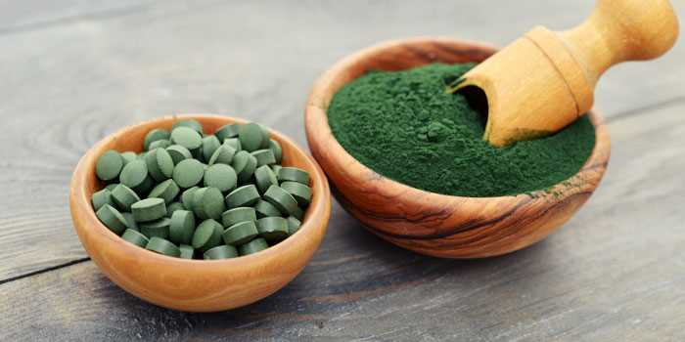
Single Cell Protein (SCP) Production
Single cell protein has a high nutritive value due to higher protein, vitamin, essential amino acids and lipid content. Hence it can form a good protein supplement. However it cannot completely replace the conventional protein sources due to their high nucleic acid content and slower in digestibility.

Slide 41
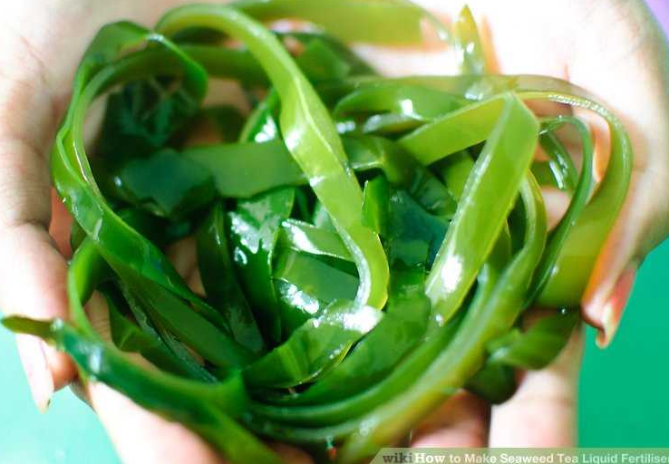
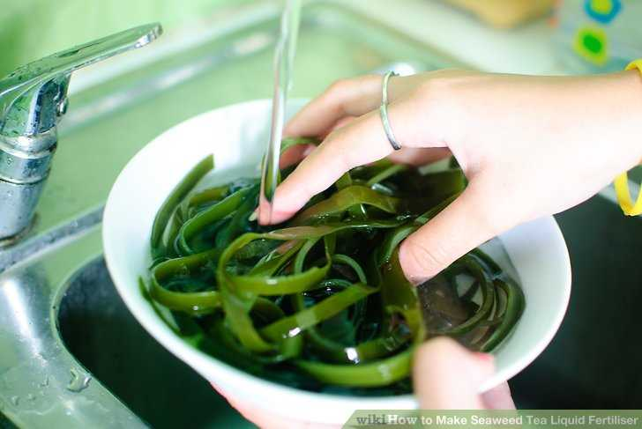
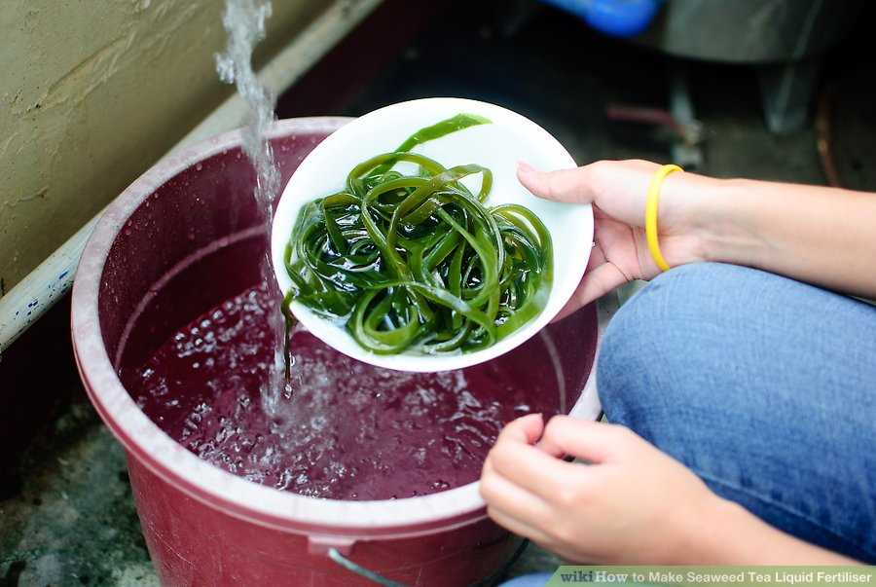
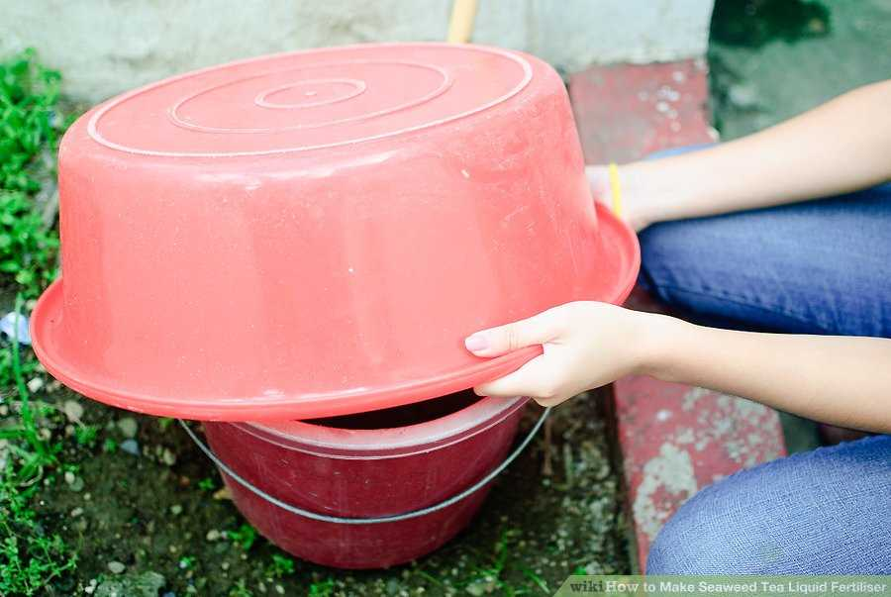
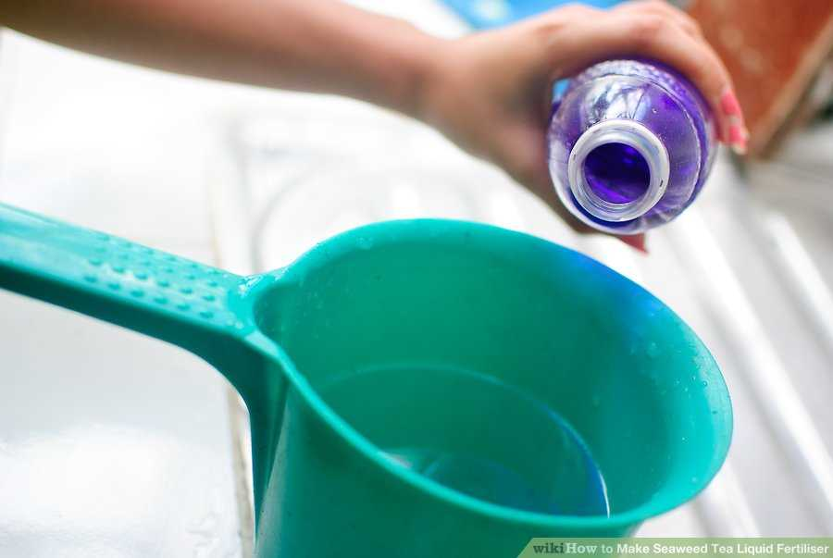
Seaweed Liquid Fertilizer
Seaweed is rich in trace elements and potassium, which makes it ideal to add to compost in its raw state, to work in as a mulch, or to create a liquid fertilizer.

Slide 43
A terrarium is a collection of small plants growing in a transparent, sealed container.
Terrarium

Slide 45
Cultivation of Medicinal and Aromatic Plants
Government of India has identified medicinal and aromatic plants as one of the sectors that can make India a global leader in the 21st century owing to the treasure of about 8,000 medicinal and 2,500 aromatic plants.
Central Institute of Medicinal and Aromatic Plants (CIMAP) has developed a number of high yielding varieties and processing technologies to promote cultivation of medicinal and aromatic plants.

Slide 46
Cultivation of Medicinal and Aromatic Plants
Cultivation of medicinal/aromatic plants offers following advantages:
Generate employment through development of ancillary industries.
Foreign exchange earnings through exports. Crops are not damaged by domestic animals or by birds.
Technologies are farmer and eco-friendly.

Slide 47
Gloriosa superba
Cymbopogon citratus

Slide 49
THANK YOU

